Slide 1
JAVA OCA 8
Module 3

Slide 2
Java Basics
Variable scope
Class structure
Executable applications
Import Java packages

Slide 3
Variable scope
Class scope
Non-static variables defined in a class are accessible within the class methods without using the class or instance name or “this”.
Static variables
Method scope
Variables declared in the method and arguments of the method are only available within the method.
If an argument of the method has the same name as a class variable, the method’s version will be used rather than the class version.
If a variable with the same name as a class variable is declared in the method, the method’s version will be used rather than the class version.
Block scope
A variable declared in a block of code will only be available in that block of code.
Variables may be declared anywhere in a block or method but will only be valid after the declaration.
Variables declared in a block will be accessible inside a new nested scope under the scope they were declared in.
You cannot declare a variable in an inner block scope with the same name as a variable in the outer block scope.
Variables are created only when their scope is entered.
Variables are destroyed when their scope is left.

Slide 4
Class structure
Static members belong to class, not instance
Can be used to keep track of how many instances of a class have been created
Constants declared with “static final” modifiers
Cannot be reassigned, compile-time error will occur
Access level modifiers
public
world accessible
protected
subclass and package accessible
package-private
default for no modifier
package accessible
private
only accessible within class

Slide 5
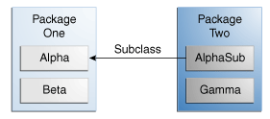
Access Levels
Modifier | Class | Package | Subclass | World
public | Y | Y | Y | Y
protected | Y | Y | Y | N
no modifier | Y | Y | N | N
private | Y | N | N | N
Example
Modifier | Alpha | Beta | Alphasub | Gamma
public | Y | Y | Y | Y
protected | Y | Y | Y | N
no modifier | Y | Y | N | N
private | Y | N | N | N

Slide 6
Executable applications
A Java class is made executable from the command line by creating a main method using the declaration: public static void main(String args[])
A main method that returns a value will compile but will produce an error when executed
First command line argument is args[0].

Slide 7
Import Java packages
Import package member using import package.member
Import complete package using the wildcard character
Java compiler automatically imports the java.lang package and the current package
If more than one package you have imported contains the same member name, you must refer to it using the member’s fully qualified name.

Slide 8
Java Data Types
Declare and initialise variables
Object reference variables
Primitive variables
Integer literals:
Floating-point literals:
Character literals:
Read and write object fields
Object lifecycle
Call object methods
StringBuilder class
Strings

Slide 9
Declare and initialise variables
Declared using syntax: type identifier
Multiple variable of the same type may be declared in the same statement, separating the identifiers with commas.
Variables may be declared and initialised on the same line.
Multiple variables of the same type may be declared and initialised on the same line, by putting a comma after the value of each variable and then supplying the next identifier.
Variables may be dynamically initialised with any valid expression at time of declaration.
There are certain rules for identifiers:
reserved words cannot be used.
they cannot start with a digit but digits can be used after the first character (e.g., name1, n2ame are valid).
they can start with a letter, an underscore (i.e., "_") or a dollar sign (i.e., "$").
you cannot use other symbols or spaces (e.g., "%","^","&","#").

Slide 10
Object reference variables
When instantiating an instance of a class, we declare a reference variable and then allocate a new instance of the class to the reference
Class name and arguments specify the constructor to be used

Slide 11
Primitive variables
8 Primitive types:
byte – 8 bits signed
short – 16 bits signed
int – 32 bits signed
long – 64 bits signed
float – 32 bits single precision
double – 64 bits double precision
char – 16 bits unicode
boolean – true or false – not 0 or 1

Slide 12
Integer literals
Whole number value is an integer literal, assumed to be decimal
Octal values denoted by a leading 0
Hexadecimal values denoted by a leading 0x
Binary values denoted by leading 0b – beginning with JDK 7
No error produced when assigning an integer literal that is within the range of the type
To specify a long literal append an L(upper-case or lower-case) to the end of the literal
Underscores may be embedded in integer literals

Slide 13
Floating-point literals
Default is double precision
To specify float, append F to the literal
To specify double, append D to the literal
Scientific notation uses a floating point number plus suffix indicated by E followed by a decimal number with is the power of 10 to which the number is multiplied.
Hexadecimal floating point literals may be used with prefix 0x, but scientific notation then uses P rather than E.
Underscores may be embedded in floating-point literals

Slide 14
Character literals
Character literals:
Enclosed in single quotes(‘)
Example : ('a', '7', '$', 'π').

Slide 15
Objects
Read and write object fields
Inside the class just use the field name.
Outside the class use the instance name, dot operator and field name.
Object lifecycle
Variables are created when their scope is entered and destroyed when their scope is exited.
Objects will be eligible for garbage collection when there is no reference pointing to them.
Call object methods
Within the class just use the method name.
Outside the class use the instance name, dot operator, method name and required arguments.

Slide 16
String Class
Strings are immutable – cannot be changed once created
A string object is automatically created for every string literal
The + operator may be used to concatenate strings
To compare two strings use the equals() or equalsIgnoreCase() methods of the String class
Use the compareTo() or compareToIgnoreCase() method to compare whether a string comes before or after another string in dictionary order.
Use length() to get length of string
String methods that return a new String object may be used with the assignment operator to replace the an existing String object.
String methods that “modify the string” don’t actually modify the string, but return a modified copy of the String.

Slide 17
StringBuilder class
Identical to String Buffer, is faster, but is not synchronized so is not thread-safe
Represents growable and modifiable character sequences
Provides utility functions for characters or substrings to be inserted into or appended onto a string.
Use append() to add more characters to the string
Use charAt() to get the character at a particular index – throws IndexOutOfBounds exception if index is invalid.
Use length() to get length of string
Use substring(int index) to return all characters from index to end of string orsubstring(int start, int end) to return characters between start and end inclusive.

Slide 18
Operators and Decision Structures
Operators
Parentheses
Object and string equality
If/else statements
Switch statements

Slide 19
Operators
Arithmetic Operators: + – * / % ++ += -= *= /= %= —
Bitwise Operators: ~ & | ^ >> >>> << &= |= ^= >>= >>>= <<=
Relational Operators: == != > < >= <=
Boolean Logical Operators: & | ^ || && ! &= |= ^= == != ?:
Assignment Operator: =
Ternary Operator: ?
Type Comparison Operator: instanceof
Watch for mixed types of operators used in unusual ways in statements.
Recognising the type of operator is important
Be sure to know your operator precedence order, particularly postfix and prefix increments and decrements and arithmetic operators.

Slide 20
Bitwise Operators
The unary bitwise complement operator "~" inverts a bit pattern; it can be applied to any of the integral types, making every "0" a "1" and every "1" a "0". For example, a byte contains 8 bits; applying this operator to a value whose bit pattern is "00000000" would change its pattern to "11111111".
The signed left shift operator "<<" shifts a bit pattern to the left, and the signed right shift operator ">>" shifts a bit pattern to the right. The bit pattern is given by the left-hand operand, and the number of positions to shift by the right-hand operand. The unsigned right shift operator ">>>" shifts a zero into the leftmost position, while the leftmost position after ">>" depends on sign extension.
The bitwise & operator performs a bitwise AND operation.
The bitwise ^ operator performs a bitwise exclusive OR operation.
The bitwise | operator performs a bitwise inclusive OR operation.

Slide 21
Operators
Parentheses
Raises the precedence of operations inside them
May be used to alter the precedence or clarify the meaning of the expression
Object and string equality
== determines if the variable references refer to the same object
.equals compares the contents of the two objects

Slide 22
Decision Structures
If/else statements
May contain just one statement or a block
May be nested, but the if-else-if ladder structure is preferred
Switch statements
Statements in a switch case must be labeled with one or more case or default labels.
break statement branches execution to first statement after switch block
break may be omitted from a case in order to have execution fall through to the next case’s statements
Prior to JDK 7 only byte, short, int or char expressions may be used in a switch.
In JDK 7 and above String may be used.
switch is more efficient than if’s, but may only test equality of contents of expression

Slide 23
Arrays
One-dimensional arrays
Braces may follow the type or the variable name.
Array memory must be allocated using the new keyword and size must be specified in braces after the type
Multi-dimensional arrays
Braces may follow the type or the variable name.
When specifying the size of a multi-dimensional array only the first dimension size needs to be specified. The second dimension size may be allocated manually for each index of the first dimension.
It is possible to create uneven or irregular multi-dimensional arrays – a triangular multi-dimensional array even!

Slide 24
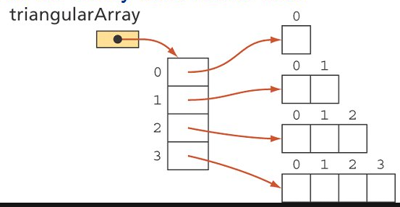
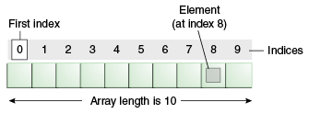
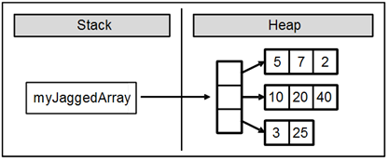
Arrays

Slide 25
java.util.Arrays & ArrayList
java.util.Arrays has utility static methods for manipulating arrays
Arrays are objects and all methods of class Object may be invoked on an array.
ArrayList
Supports dynamic arrays which can grow when needed.
Automatically enlarged when needed.
May be shrunk when objects are removed.
Declared in form: ArrayList<type> var = new ArrayList<type>()
Contents may be returned using default toString() method.
Can be converted to an array using toArray() method. Needed for use with an enhanced-for loop.
Use get(index) method to access a value.
Use add(element) to append to list
Use add(index, element) to insert in a list – index must be less than the size() of the ArrayList.
Use remove(index) to remove from ArrayList.
Use remove(object) to remove the first occurrence of object from the ArrayList.
Use clear() to remove all elements from the arraylist.

Slide 26
Loops
While loops
Only run if controlling expression is true
May not run at all if expression is false when execution reaches the loop
Does not require a body if the controlling expression can handle all required functionality
For loops
General form: for(initialisation; condition; iteration)
Commas allow multiple initialisation and iteration statements
Initialisation and/or iteration statements may be absent
All three parts may be empty for an infinite loop
Enhanced for loops
General form: for(type variable : collection)
Iterates through a collection and places the current value in the variable
May be used for multi-dimensional arrays using nesting

Slide 27
Loops
Do/while loops
Always runs once, subsequent runs will occur if the controlling expression is true at the end of the first iteration.
Decrement/Increment may be included in the controlling expression as a pre-fix decrement/increment preceding the comparison
Break and continue
break terminates the loop and execution continues with the first statement after the loop
continue terminates the current loop iteration and execution continues with the next loop iteration
break label breaks out of the named block of code
continue label ends the current iteration of the block label and triggers the next iteration to begin
break may only be used within a switch block’s case or default labels or in a loop.
continue may only be used in a loop.

Slide 28
Methods and Encapsulation 1
Method arguments and return values
A method may accept values into variables which are known as parameters
A method that accepts parameters is passed arguments(variables or literals) when it is called
Void methods do not return values or include a return statement.
Non-void methods must return a value via the return statement.
The last parameter of a method may be a varargs parameter which may accept an arbitary number of values. The syntax is: type… array_name
Static keyword
Static variables are essentially global variables
Static methods can only directly call other static methods
Static methods can only directly access static data
Static methods cannot use this or super – it will cause a compilation error
Static members can be accessed before an instance of its class is created and without reference to an object.
Inside their class static members can be used without specifying the name of the class.
Outside their class static members can be used by specifying the class name followed by the dot operator and member name.

Slide 29
Methods and Encapsulation 2
Overloaded methods
Overloaded method use the number and types of arguments to determine which version of the overloaded method to call.
Return type are not used to determine which overloaded method to call.
Default and user-defined constructors
If no user-defined constructors are provided for a class, the compiler will supply a default no argument constructor
Create and overload constructors
If a class will be inherited, a no argument constructor should be supplied.
Access modifiers
public
Can be accessed by any other code
private
Can only be accessed by other methods in its class
protected
Applies only with inheritance
default
Also known as package-private
Accessible from all classes within its package

Slide 30
Methods and Encapsulation 3
Encapsulation
Declare variables of a class private
Provide public setter and getter methods
Call by reference vs call by value
Primitives types are passed by value – the method has a copy of the primitive and can’t change the original variable
Object types are passed by reference – the method can change the original object

Slide 31
Inheritance 1
Implementing inheritance
Java implements single inheritance
On instantiation of a subclass, the no-arg constructor of the superclass will be executed prior to the subclass constructor running
Subclass cannot access those members of a superclass that have been declared private
Declaring a method as final means it cannot be overriden by a subclass – a compile-time error will occur
Declaring a class as final means it cannot be inherited.
A class cannot be abstract and final
Polymorphism
Subclasses of a class can implement their own unique behaviour but share common functionality with the superclass
Achieved by overriding superclass methods to provide unique behaviour in the subclass, while also adding additional unique methods specific to the subclass
Reference type vs object type
A reference variable may be declared to be of a type that is a superclass of the actual object type
Reference type determines which members of the object are accessible
Only those members declared in the reference type will be accessible, so some members of actual object type may not be accessible

Slide 32
Inheritance 2
Casting
Where a superclass has been used as reference type, the object may be cast to the actual type to access members that are not part of the reference type
Super
May be used to call the constructor of a superclass – the signature will determine which constructor
May be used to refer to a method or instance variable in the superclass
This
this is a reference to the current object
this() can be used to invoke an overloaded constructor
this may be used to refer to a redefined instance member variable from a method.

Slide 33
Inheritance 3
Interfaces
An interface is a a reference type, like a class, that can only contain constants, method signatures, default methods, static methods and nested types.
Cannot be initialised
Are designed to be implemented by classes or extended by other interfaces
A class based on the interface uses the implements keyword to declare this.
Abstract classes and interfaces
Abstract classes cannot be initialised
Abstract classes are able to be subclassed, with subclasses inheriting the methods provide by the abstract class
An abstract class may implement an interface

Slide 34
Exceptions 1
Checked exceptions
All exceptions and errors are subclasses of Throwable.
Throwable defines a method getMessage() which returns a string with details of the exception or error
Throwable defines a method printStackTrace() which prints a stack trace of the exception or error to the console.

Slide 35
Exceptions 2
Exceptions other than subclasses of RuntimeException, Error
RuntimeExceptions
Subclasses of RuntimeException are unchecked by the compiler
Common RuntimeException subclasses:
ArithmeticException
IndexOutOfBoundsException
IllegalArgumentException
NoSuchElementException
NullPointerException
Errors
Subclasses of Error are unchecked by the compiler
Not expected to be caught under normal circumstances by your program.
Indicates errors with the run-time environment
Created in response to catastrophic failures that cannot be handled by your program
Common Error subclasses:
IOError
Common checked exceptions:
IOException

Slide 36
Exceptions 3
Try-catch blocks
Try
Encloses a block of code that might throw an exception
Catch
Catch blocks must catch exception subclasses before any of their superclasses.
Subclass catch blocks would not be reached if superclass catch blocks came first. Unreachable code in Java causes a compile error.
Multiple exceptions can be handled by the same catch block by using the pipe operator |
Execution never returns to the try block
Finally
Code in the finally block is always executed after the try block completes

Slide 37
Exceptions 4
Uses of exceptions
Definition: An exception is an event, which occurs during the execution of a program, that disrupts the normal flow of the program’s instructions.
When an exception is thrown the runtime system searches down the call stack looking for an appropriate handler.
Using a method that throws an exception
Must catch or re-throw the exception
Common exception classes and categories
A method that can cause an exception it doesn’t handle must declare it in the method definition using the throws clause.

Slide 38
Les expressions Lambdas
Les expressions lambda permettent d'écrire du code plus concis, donc plus rapide à écrire, à relire et à maintenir.
C'est aussi un élément important dans l'introduction de la programmation fonctionnelle dans le langage Java qui était jusqu'à la version 8 uniquement orienté objet.
Une expression lambda est une fonction anonyme : sa définition se fait sans déclaration explicite du type de retour, ni de modificateurs d'accès ni de nom.
C'est un raccourci syntaxique qui permet de définir une méthode directement à l'endroit où elle est utilisée.

Slide 39
La syntaxe des expressions lambdas
La liste des paramètres
Le type est optionnel
Les parenthèses peuvent être omises
La ->
Le corps de la fonction
Sans {} s’il y a une seule expression
Avec {} sinon

Slide 40
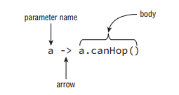
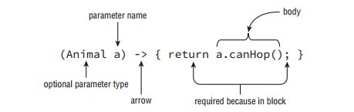
Usage des expressions lambdas
Le besoin d’expressions courtes
L’expression de prédicat
Une fonction courte qui retourne true ou false
La fourniture d’un consommateur
Une fonction qui accept une donnée

Slide 41
Les objectifs de l’API Date
Un nouveau package apparaît : java.time
Les classes sont « immutable value »
Les classes représentent correctement le domaine, donc pas de confusion
La classe java.util.Date ne possédait pas de zone
Des chronologies différentes de ISO-8601 sont possibles

Slide 42
LocalDate & LocalTime
Ce sont des classes qui représentent date et heure sur le poste courant
Il existe aussi LocalDateTime
Le contexte de zone n’existe pas
Méthodes de création : now, of, from, parse

Slide 43
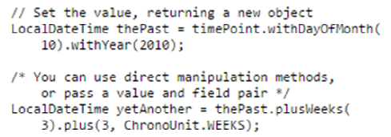
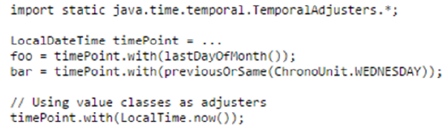
LocalDate & LocalTime
La classe la « modification » des données se fait avec with
Les « ajusteurs », certains standards et sinon à écrire soi-même
Possibilités de tronquer les infos

Slide 44
La gestion du temps local
La classe LocalDate
Les constantes MAX et MIN
Les méthodes
Création de LocalDateTime : atTime, …
Getters : getDayOfMonth()…
Informations sur le mois, l’année …
Date maintenant
Modifications : minus, plus, withXXX

Slide 45
La gestion du temps zoné
La classe ZonedDateTime
Les créateurs of, now, …
Les modificateurs plus, minus, with, …
Temps restant : until
Travail sur offset : getOffset()

Slide 46


Les classes de zones
Une zone peut être représentée par une chaîne de caractères
La classe ZoneId sert à garder cette information
ZonedDateTime est une date/heure avec les informations de zone
OffsetDateTime est une date/heure avec l’offset (de zone UTC)
OffsetTime est une heure avec l’offset

Slide 47

Les classes Period et Duration
La classe Period représente une durée en jour-mois-année et non un point dans le temps
La classe Duration représente des durées en heures, etc plus précis que Period

Slide 48
Le package java.time.format
Fournit des classes pour afficher et parser des dates
La classe DateTimeFormatter est suffisante pour la plupart des cas
Pour les situations complexes, on utilisera DateTimeFormatterBuilder
Les classes du package ne supportent pas des arguments null

Slide 49

La classe DateTimeFormatter
Cette classe proposent de formatter des dates en chaînes de caractères ou de lire une chaîne en date
Utilise des constantes prédéfinies
Utilise des motifs prédéfinis
Utilise des styles prédéfinis

Slide 50
DateTimeFormatterBuilder
Le builder de base des DateTimeFormatter
Il permet de faire apparaître les éléments suivants :
Valeur, Fraction, Text
OffsetId/Offset, ZoneId, ZoneText
ChronologyId, ChronologyText
Literal
Nested et Optional
Chaque élément peut être arrangé avec des espaces/caractères avant et après

Slide 51
DateTimeFormatter
Méthodes ofLocalizedDate, Time
Des formatters prédéfinis : BASIC_ISO_DATE, …
Des méthodes de construction : ofPattern(…)
« yyyy MM dd »
Format à découvrir dans la documentation

Slide 52
Les chronologies
Un package java.time.chrono
Une interface Chronology, représentant un système calendaire
Des classes implémentant cette interface : IsoChronology, JapaneseChronology,…
Ce sont des factories pour des ChronoLocalDate (interface)
Méthodes dateNow(), dateNow(..), date(…)
Classes implémentant ChronoLocalDate : LocalDate, JapaneseDate,…

Slide 53
Le package java.time.chrono
Décrit les classes de chronologies
L’interface Chronology : représente un système calendaire
Il est possible d’ajouter de nouveaux calendriers en créant une implémentation Chronology, ChronoLocalDate et Era.
Chronology fonctionne comme une factory

Slide 54
Manipuler les chronologies
Trouver les chronologies disponibles
Créer une date : dateNow, date, dateYearDay…
Manipuler des ChronoLocalDate et des ChronoPeriod
Obtenir des ChronoZonedDateTime

Slide 55
Les dates selon les chronologies
Chaque chronologie a sa propre représentation
Un style de date et d’heure
FormatStyle (FULL, LONG, MEDIUM, SHORT)
Un style décimal
DecimalStyle (STANDARD)
Méthode of(Locale)

Slide 56
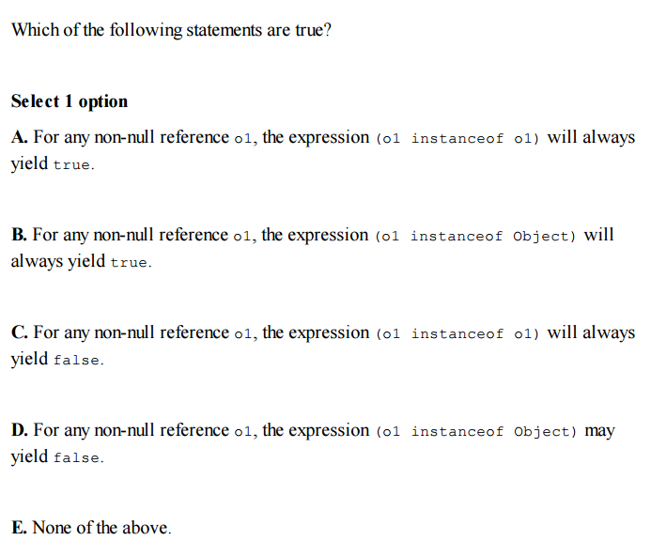
Quizz

Slide 57
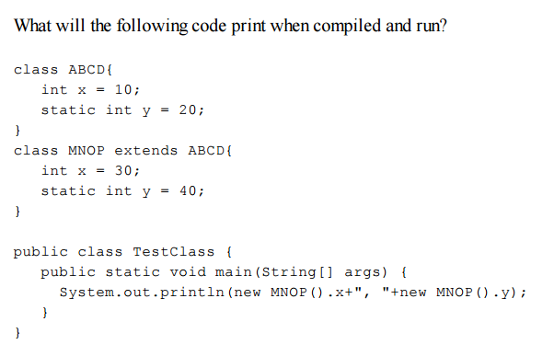
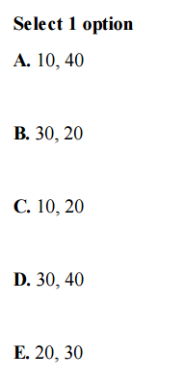

Quizz

Slide 58
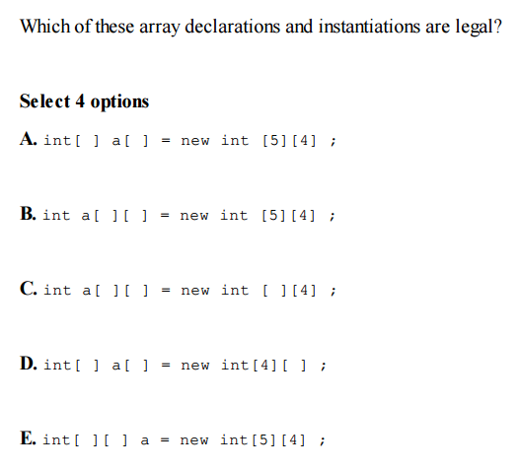
Quizz

Slide 59
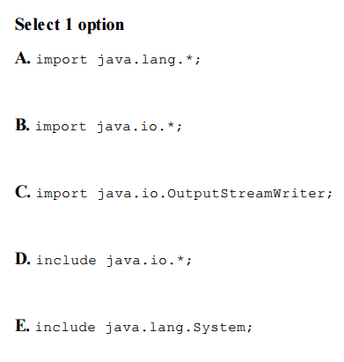
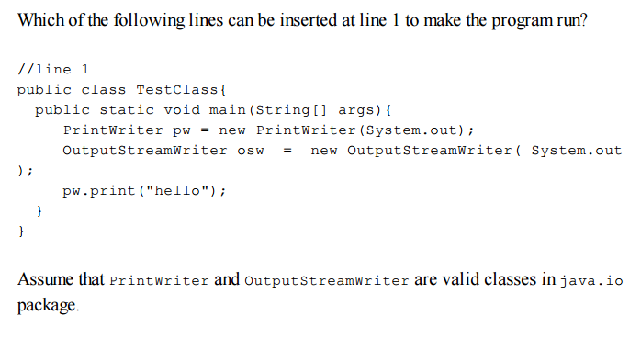
Quizz

Slide 60
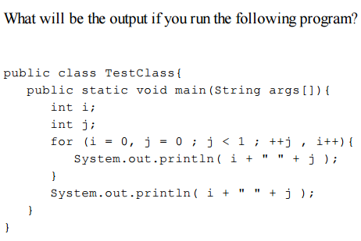
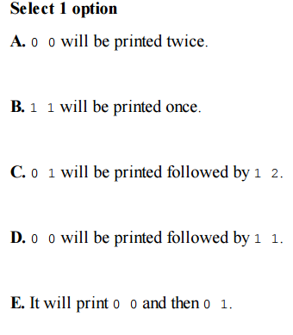
Quizz

Slide 61
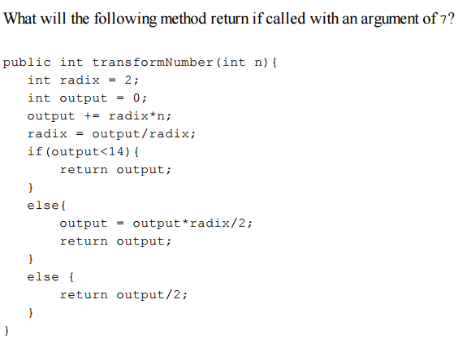
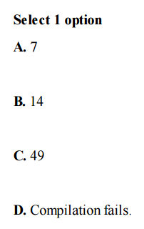
Quizz

Slide 62
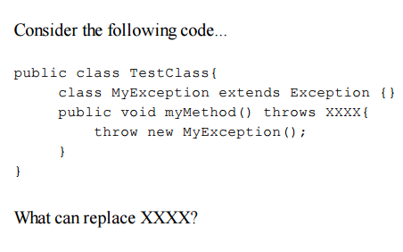
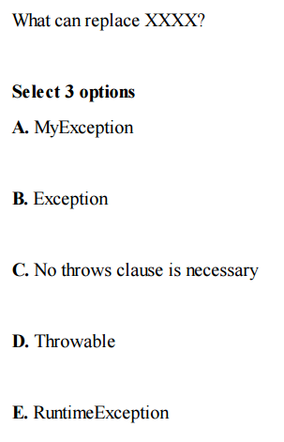
Quizz

Slide 63
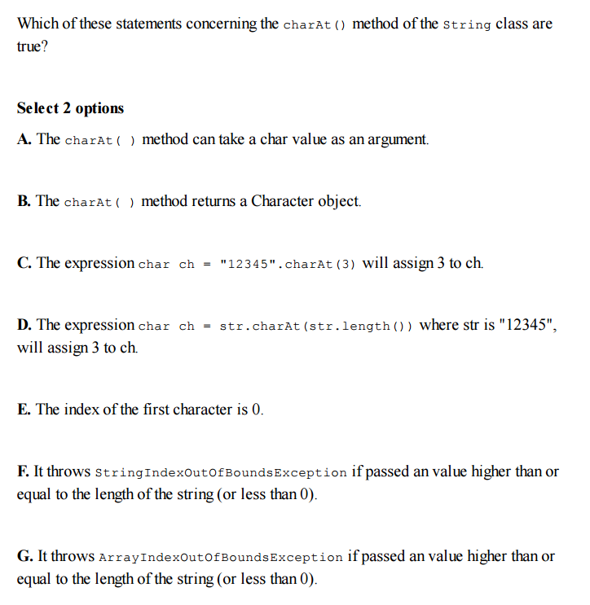
Quizz

Slide 64
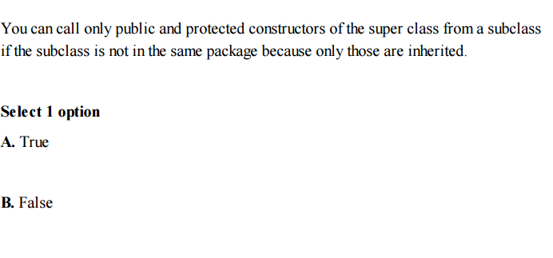
Quizz

Slide 65
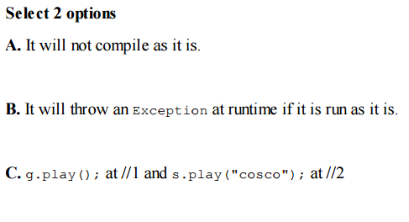
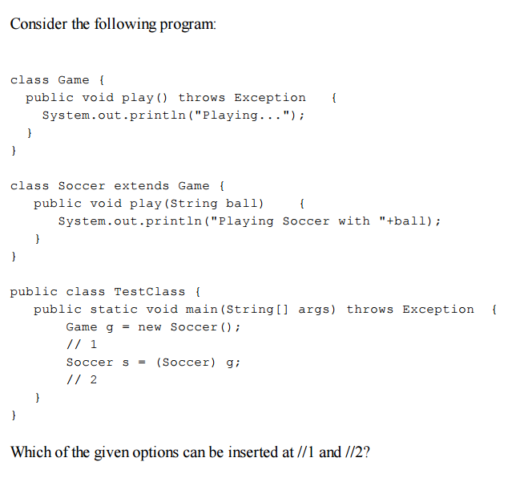
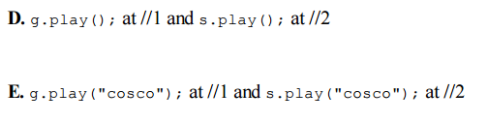
Quizz

Slide 66
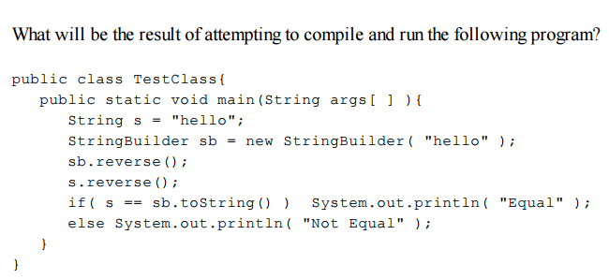
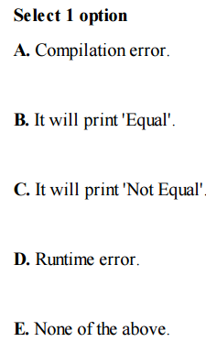
Quizz

Slide 67
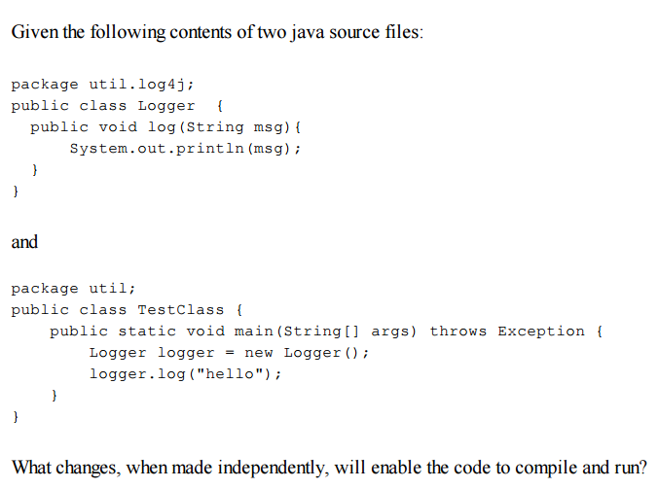
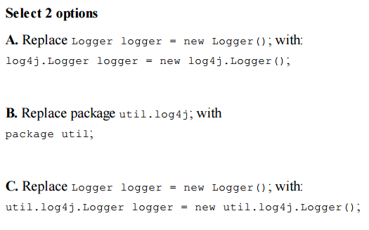
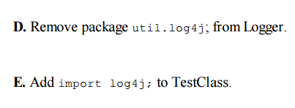
Quizz

Slide 68
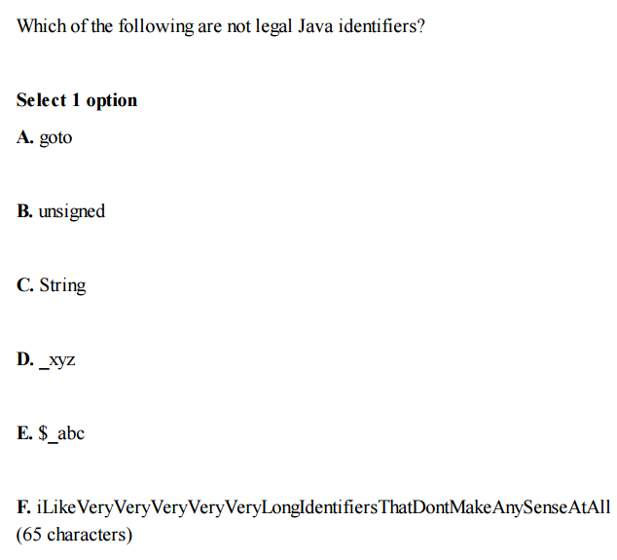
Quizz

